Slide 1
Regression Testing & Testcase selection

Slide 2
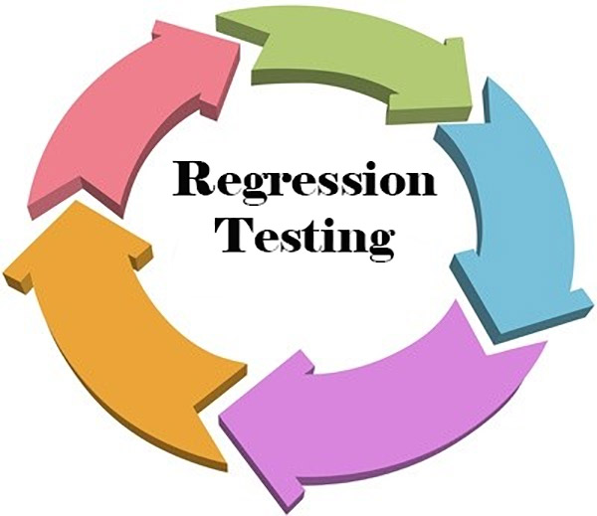
Regression Testing
What is Regression Testing?
Confirm that a recent program or code change has not adversely affected existing features
Ensure that new code changes do not have side effects on the existing functionalities

Slide 3
Regression Testing
Why is Regression Testing?
Need for regression testing whenever the code is changed
Determine whether the modified code will affect other parts of the software application
Needed when a new feature is added to the software application
Also be performed when a functional or performance defect/issue is fixed.

Slide 4
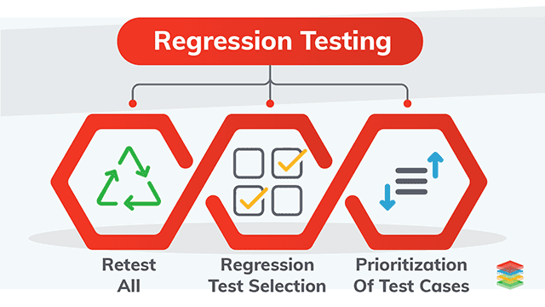
Regression Testing
How to do Regression Testing?
Regression testing is done by selecting relevant test cases from the test suite that covers both modified and affected parts of the code
Using the following techniques:

Slide 5
How to do Regression Testing?
Retest All
All the tests in the existing test bucket or suite should be re-executed.
Very expensive as it requires huge time and resources.

Slide 6
How to do Regression Testing?
Regression Test Selection
Some selected test cases from test suite are executed to test whether the modified code affects the software application or not

Slide 7
How to do Regression Testing?
Prioritization of Test Cases
Selection of test cases based on priority will greatly reduce the regression test suite
Depending on business impact, critical & frequently used functionalities

Slide 8
Thank You

